Slide 1

Forum for Nuclear Cooperation in Asia (FNCA)
- Radiation Oncology Project for Cervical Cancer-
Shingo Kato M.D. Ph.D.
Project Leader
FNCA Radiation Oncology Project
Saitama Medical University, Japan
Notes:
I am Dr. Kato, the Project Leader of the FNCA Radiation Oncology Project.
FNCA radiation oncology project was launched in 1993. Since then, we have been conducting several activities to establish the optimum treatment for predominant cancers in Asia, including cervical cancer, nasopharyngeal cancer, and breast cancer, for about 3 decades.
Today, I would like to introduce our project for cervical cancer.

Slide 2
Mortality from Cervical Cancer
Notes:
Cervical cancer is the 4th most common cancer in women, and the 7th overall in the world. This disease is predominant in low or middle income countries in south-east Asia, Africa, and Latin America.
It is very important for these countries to develop and establish the optimum treatment for this disease.

Slide 3
Presentation
Radiotherapy for Cervical Cancer
Concurrent Chemoradiotherapy (CCRT) for Locally Advanced
Cervical Cancer
3. 3D image-guided brachytherapy (3D-IGBT) for Cervical Cancer
4. FNCA Clinical Trials for Cervical Cancer
Notes:
These are the contents of my presentation.
First, I would like to briefly talk radiotherapy for cervical cancer.
Next, I would like to talk the combination of radiotherapy and chemotherapy for advanced cervical cancer.
And next, I would like to introduce 3D image guided brachytherapy for cervical cancer. This is a cutting-edge treatment for the disease.
And finally, I would like to talk our FNCA clinical trials for cervical cancer.

Slide 4
Presentation
Radiotherapy for Cervical Cancer
Concurrent Chemoradiotherapy (CCRT) for Locally Advanced
Cervical Cancer
3. 3D image-guided brachytherapy (3D-IGBT) for Cervical Cancer
4. FNCA Clinical Trials for Cervical Cancer
Notes:
First, radiotherapy for cervical cancer.

Slide 5
NCI-USA Guideline for Cervical cancer
Stage IB, IIA
1) Radiotherapy
2) Surgery (Radical hysterectomy + PLA)
3) Surgery + adjuvant chemoradiotherapy
for postoperative high-risk group
4) Concurrent Chemoradiotherapy for large tumor
Stage IIB, III, IVA
1) Concurrent Chemoradiotherapy
(http://www.cancer.gov/cancerinfo/pdq/treatment)
Notes:
This slide shows the treatment guideline for cervical cancer.
For limited stage of the disease, the standard treatment is surgery or definite radiotherapy.
If a patient has locally advanced stage of the disease, the standard treatment is the simultaneous combination of radiotherapy and chemotherapy, which is called concurrent chemoradiotherapy.

Slide 6
Radiotherapy for Cervical Cancer
Brachytherapy
External Beam Radiotherapy
small intestine
Uterus
Uterus
Lymph node
Bladder
Cervical tumor
Parametrium
vagina
Rectum
¹³⁷Cs, ⁶⁰Co, or ¹⁹²Ir
is commonly used.
Liniac → X - ray
Cobalt → γ - ray
Notes:
Definitive radiotherapy for cervical cancer consists of external beam radiotherapy to the pelvis and brachytherapy to the cervical tumor.

Slide 7
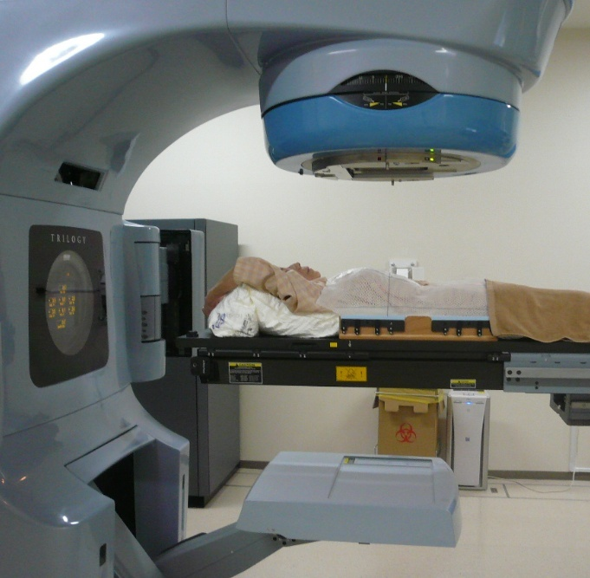
External Beam Radiotherapy
Uterus
Lymph node
Cervical tumor
Parametrium
Radiation: Linac high energy X-rays or ⁶⁰Co γ-rays
Fractionation: daily, 5 times/week (Mon-Fri), total 5~6 weeks
Clinical target volume: cervical tumor, whole uterus, vagina, parametria,
and pelvic lymph nodes.
Notes:
External beam radiotherapy is a treatment which irradiate the clinical target volume with high energy X-rays or Co-60 gamma rays. The treatment is given once daily, 5 times a week, totally for about 5 to 6 weeks.
The clinical target volume includes the cervical tumor, whole uterus, at least the upper vagina, parametria, and the pelvic lymph nodes.

Slide 8
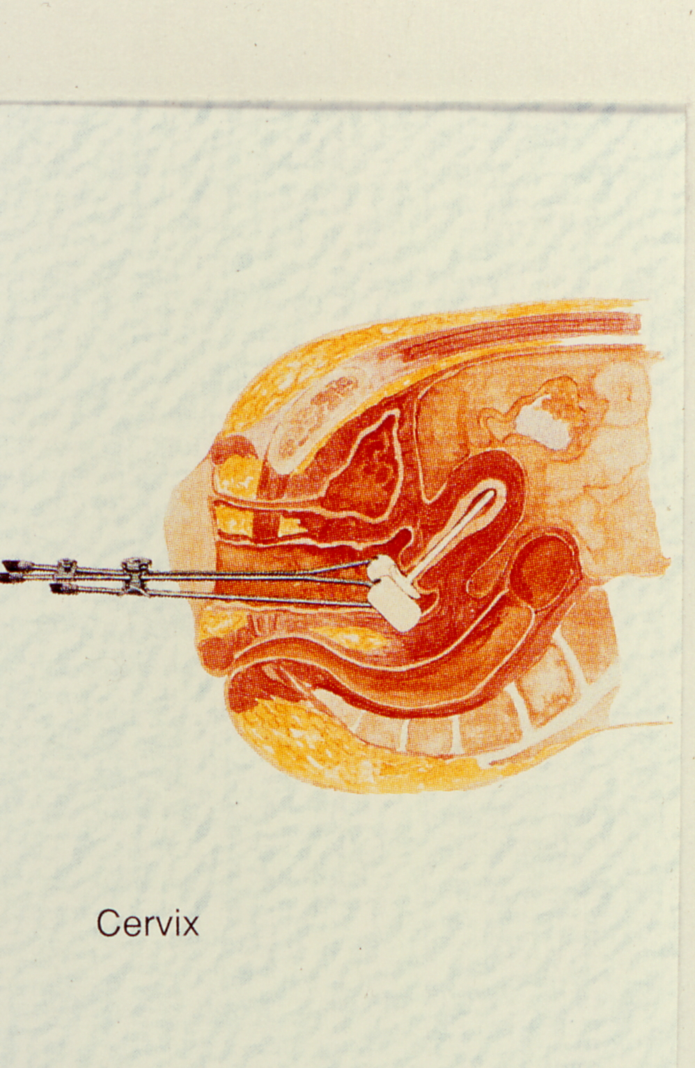
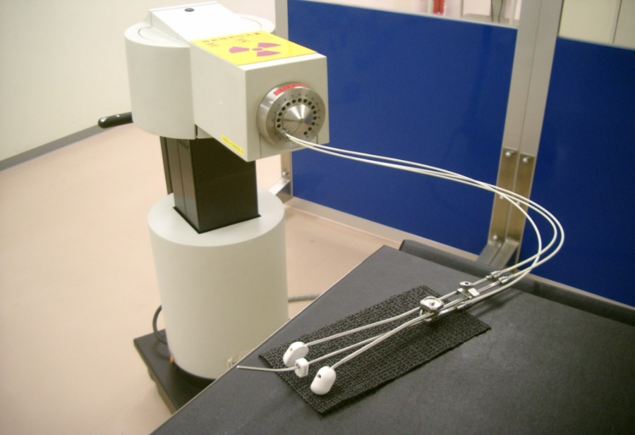
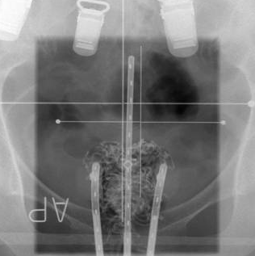
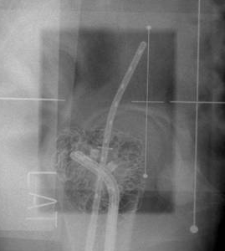
Brachytherapy
Uterus
Bladder
Vagina
Rectum
Applicators
Intrauterine tandem
applicator
Vaginal colpostat
(ovoid applicators)
Insert radioactive sources (⁶⁰Co or ¹⁹²Ir) into the tumor volume (uterine and vaginal cavity)
Irradiate a very high radiation dose precisely to the tumor
Fractionation: 1-2 times/week, total 4 times
Notes:
Brachytherapy is a treatment to insert radioactive sources, such as Co-60 or Ir-192, into the tumor volume.
This treatment can irradiate a very high radiation dose precisely to the cervical tumor, while minimizing doses to the normal organs such as the rectum, sigmoid colon, and bladder. This treatment can produce high local tumor control and low rate of late radiation toxicities.
Brachytherapy is generally given once or twice a week, 4 times in total.

Slide 9
Presentation
Radiotherapy for Cervical Cancer
Concurrent Chemoradiotherapy (CCRT) for Locally Advanced
Cervical Cancer
3. 3D image-guided brachytherapy (3D-IGBT) for Cervical Cancer
4. FNCA Clinical Trials for Cervical Cancer
Notes:
Next, I would like to show concurrent chemoradiotherapy for advanced cervical cancer.

Slide 10
Major phase III studies of RT vs. CCRT
for locally advanced cervical cancer
Study
RTOG 9001
(USA) 1-2)
GOG 85
(USA) 3)
GOG 120
(USA) 4-5)
NCIC
(Canada) 6)
Treatment
1) RT + CDDP+5FU
2) Extended-field RT
1) RT + CDDP+5FU
2) RT + HU
1) RT + CDDP
2) RT + CDDP+5FU+HU
3) RT + HU
1) RT + CDDP
2) RT alone
No. of
Patients
194
195
177
191
176
173
177
127
126
Eligibility
Staging method for PALN
IB2 or IIA2 (> 5 cm or PLN(+))
IIB, III, IVA
LG or Surgical staging
IIB, III, IVA
Surgical staging
IIB, III, IVA
Surgical staging
IB2, IIA2 (> 5 cm)
IIB, III, IVA
CT staging
1) Morris et al, NEJM, 1999. 2) Eifel et al, JCO, 2004. 3) Whiteney et al, JCO, 1999. 4) Rose et al, NEJM, 1999. 5) Rose et al, JCO, 2007. 6) Pearcy et al, JCO 2002
Notes:
Locally advanced cervical cancer was traditionally treated with radiotherapy alone or radiotherapy plus mild anticancer drug hydroxyurea (HU). However, the treatment outcomes were unfavorable.
To improve the treatment outcomes, several phase III clinical studies of concurrent chemoradiotherapy (CCRT) were conducted in the US or Canada in 1990s.
This table shows the major clinical studies conducted by RTOG and GOG in the US and NCI-Canada. They compared the treatment results of cisplatin-based chemoradiotherapy and conventional radiotherapy.

Slide 11
Major phase III studies of RT vs. CCRT
for locally advanced cervical cancer
Study
RTOG 9001
GOG 85
GOG 120
NCIC
Treatment
1) RT + CDDP+5FU
2) Extended-field RT
1) RT + CDDP+5FU
2) RT + HU
1) RT + CDDP
2) RT + CDDP+5FU+HU
3) RT + HU
1) RT + CDDP
2) RT alone
5-year OS
(%)
73
52
65
51
60
61
40
62
58
P value
< 0.0001
0.018
< 0.001
< 0.001
0.42
Follow-up
(mo.)
79
104
106
82
Notes:
This table shows the treatment results.
Most studies showed that CCRT produced significantly more favorable survival outcomes compared to RT alone or RT + hydroxyurea.

Slide 12
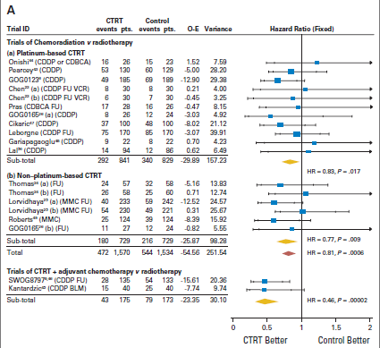
CCRT for locally advanced cervical cancer
a meta-analysis
(15 trials, n=3452)
Platinum-based CTRT
HR=0.73, p=0.017
Non-platinum-based CTRT
HR=0.77, p=0.009
HR=0.81, p=0.0006
CTRT + adjuvant CT
CCRT > RT
(Chemotherapy for cervical cancer meta-analysis collaboration
J Clin Oncol 26: 5802-5812, 2008.)
HR=0.46, p=0.0002
Notes:
In the 1990s and the 2000s, many clinical studies were conducted to compare the outcomes of CCRT and RT alone.
This slide shows the results of a meta-analysis which evaluated the safety and efficacy of CCRT. CCRT demonstrated significant survival advantage when compared with radiotherapy alone.
Based on these results, CCRT using cisplatin-based chemotherapy has become the standard treatment for locally advanced cervical cancer in the world.

Slide 13
Schedule of Concurrent Chemoradiotherapy
week
1
2
3
4
5
6
7
8
EBRT
（5/week, 5-6weeks）
Brachytherapy
（1-2/week, 4 times）
CT
MRI
MRI
CT
CT
CT
CT
Images
Chemotherapy
(1/week, 5-6 times）
Notes:
This slide shows the schedule of concurrent chemoradiotherapy.
Anticancer drug, cisplatin, is administered weekly, concurrently with external beam radiotherapy for 5 or 6 weeks.
Regarding radiological exams, CT and MRI are taken before treatment.
And the 2nd MRI is taken just before brachytherapy to evaluate the residual tumor volume.
And CT is taken at the time of brachytherapy for 3D-IGBT treatment planning.

Slide 14
Presentation
Radiotherapy for Cervical Cancer
Concurrent Chemoradiotherapy (CCRT) for Locally Advanced
Cervical Cancer
3. 3D image-guided brachytherapy (3D-IGBT) for Cervical Cancer
4. FNCA Clinical Trials for Cervical Cancer
Notes:
Next, I would like to introduce 3D-IGBT.

Slide 15
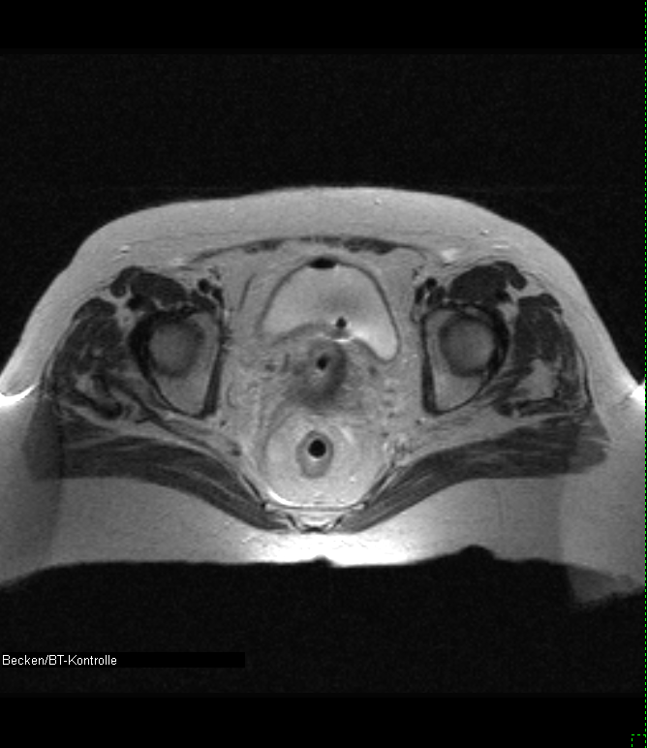
3D Image-Guided Brachytherapy (3D-IGBT)
Bladder
GTV
HR-CTV
IR-CTV
Rectum
MRI/CT can clearly visualize the cervical rumor, uterus, and normal tissues (bladder, rectum, sigmoid colon, and the small intestine).
3D-IGBT allows assessment of 3D dose distributions for tumor and normal tissues. 3D-IGBT can optimize dose distributions and enables to deliver high dose to tumor with minimizing doses to normal tissues.
(Kirisits C. et al. Int J Radiat Oncol Biol Phys 62: 901–911, 2005)
Notes:
This slide shows 3D-IGBT treatment planning.
As the left figure shows, MRI/CT can clearly visualize the cervical rumor, uterus, and surrounding normal tissues, such as the bladder, rectum, sigmoid colon, and the small intestine.
The right figure shows the dose distributions of brachytherapy projected onto the MRI/CT image. The doses delivered to tumor and normal tissues can be precisely evaluated.
And 3D-IGBT can optimize dose distributions and enables to deliver high dose to the tumor with minimizing doses to the normal tissues.

Slide 16
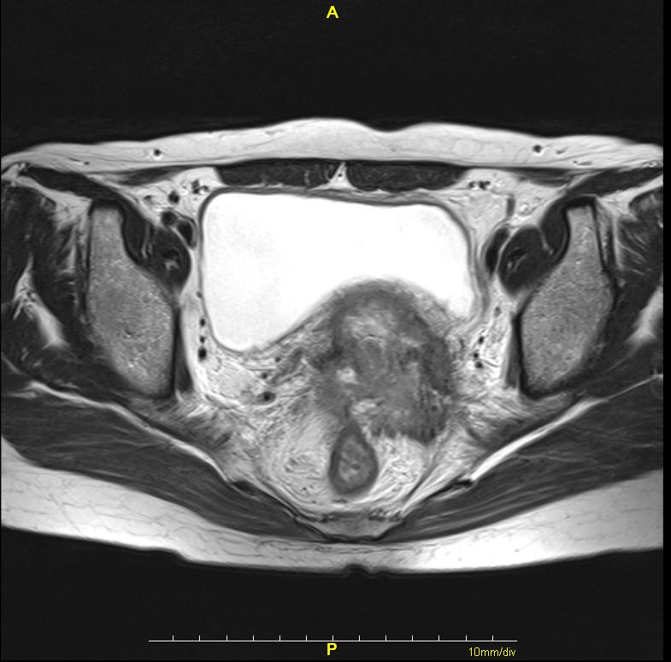
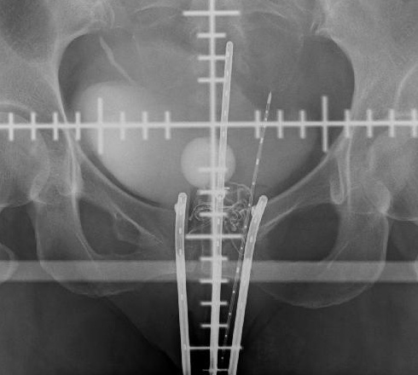
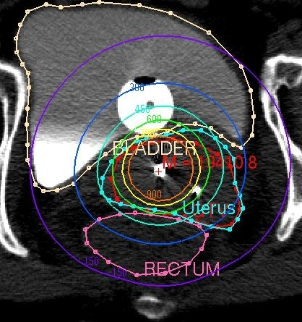
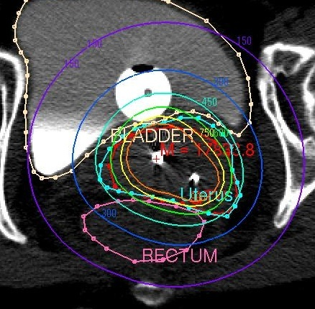
3D-IGBT: Intracavitary + Interstitial BT
Intracavitary
applicators
Interstitial
needle
Extensive & huge tumor
Intracavitary + interstitial
(IC +IS) BT can produce
optimum dose
distributions to the tumor
& OARs.
tumor
(Wakatsuki M, et al.
JRR 52: 54-58, 2011.)
Intracavitary BT only
Intracavitary + interstitial BT
Notes:
This is an example of dose distribution optimization. This patient had a huge tumor in her uterine cervix infiltrating widely to the left parametrium. In this case, it was difficult to cover the whole tumor with intracavitary brachytherapy only. So, an interstitial needle was added to produce optimum dose distributions. The tumor was successfully covered with a high dose without increasing doses to the normal tissues.

Slide 17
Treatment results; 2D-BT vs. 3D-IGBT
 | No. of Pt | Stage | Histology | Local control | Overall survival
RTOG9001 (1999) | 194 (CCRT) | IB-IIA/IIB/III/IV: 33%/36%/27%/3% | SCC: 91% | 71% (III-IVA 5y) | 59% (III-IVA 5y)
GOG 120 (1999) | 349 (CCRT) | II-III/IVA: 97%/3% | SCC: 93% | 78% (II-IVA 5y) | 60% (II-IVA 5y)
Gunma U. (2011) | 86 | I/II/III/IV: 22%/41%/34%/3% | SCC: 85% | 94% (I-IVA 5y) | 86% (I-IVA 5y)
Saitama M. U. (2019) | 162 | I/II/IIII-IVA: 7%/32%/54%/7% | SCC: 85% | 93% (I-IVA 3y) | 86% (I-IVA 3y)
2D
3D
Notes:
This table compares the treatment outcomes of the conventional 2D-BT and 3D-IGBT. 3D-IGBT could increase the dose to the tumor and significantly improved local tumor control and overall survival rates.

Slide 18
Late toxicity; Conventional 2D-BT vs. 3D-IGBT
3D-IGBT: Rectum D2cc < 70-75 Gy, Bladder D2cc < 80-90 Gy
 | No. of pts | Stage | Rectum ≥ Grade3 | Bladder ≥ Grade3
RTOG 9001 (1999) | 194 (CCRT) | IB-IIA/IIB/III/IV | 9% | 3%
GOG 85 (1999) | 177 (CCRT) | IIB/III/IV
Gunma U. (2011) | 86 | I/II/III/IV | 0% | 1%
Saitama M. U. (2019) | 162 | I/II/IIII/IV | 2% | 2%
2D
16.2%
3D
Notes:
This table compares the treatment complications of conventionl 2D-BT and 3D-IGBT.
3D-IGBT could minimize the doses to the rectum and bladder, and significantly decreased the incidence of radiation complications of these organs.

Slide 19
Presentation
Radiotherapy for Cervical Cancer
Concurrent Chemoradiotherapy (CCRT) for Locally Advanced
Cervical Cancer
3. 3D image-guided brachytherapy (3D-IGBT) for Cervical Cancer
4. FNCA Clinical Trials for Cervical Cancer
Notes:
Finally, I would like to introduce the FNCA clinical trials for cervical cancer.

Slide 20
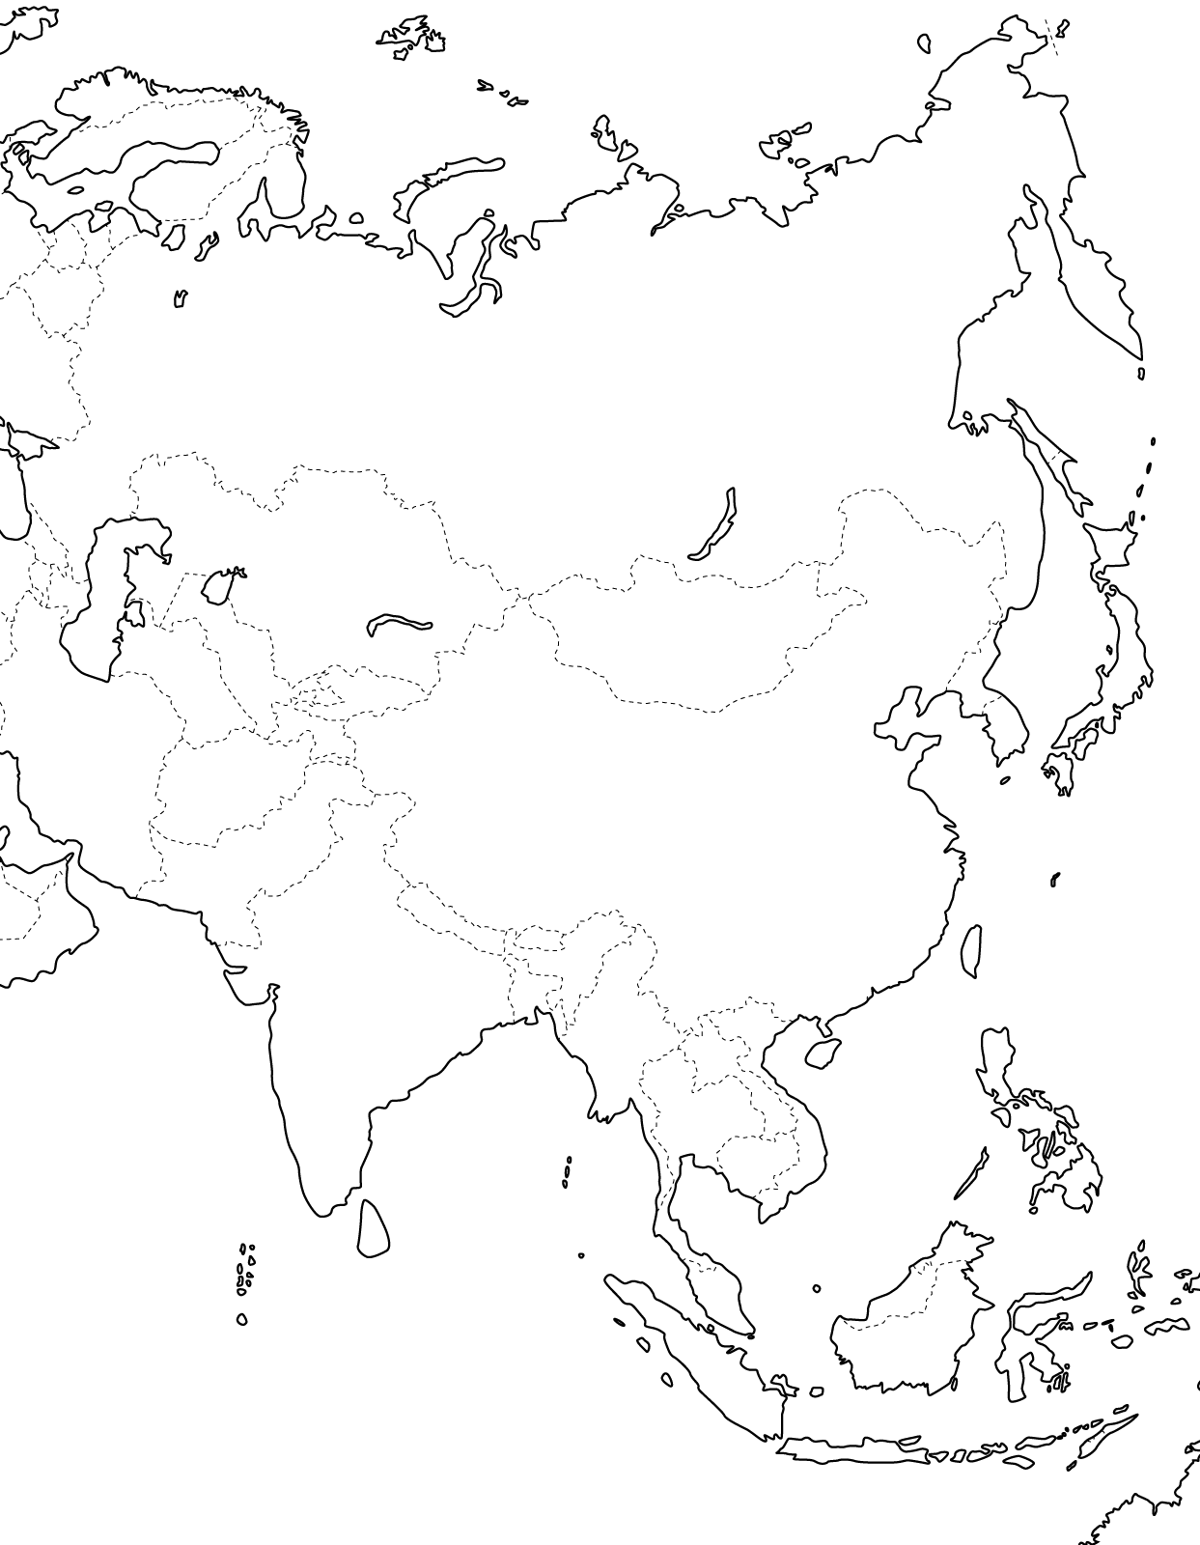











FNCA Radiation Oncology Project (since 1993)
Participating countries
Purposes of the Project
To establish optimal treatment protocols of radiotherapy and chemotherapy for predominant cancers in Asia.
To improve the quality of radiotherapy in FNCA Member Countries.
To improve treatment outcomes of predominant cancers in Asia.
JPN
KAZ
MNG
KOR
CHN
BAN
THA
PHL
MYS
VNM
IDN
Notes:
20
20
FNCA radiation oncology project was launched in 1993. Now, these 11 countries are participating in the project.
The purposes of the project are to establish the optimal treatment protocols of radiotherapy and chemotherapy for predominant cancers in Asia, and to improve the quality of radiotherapy in FNCA Member Countries. And finally we are aiming to improve treatment outcomes of predominant cancers in Asia.

Slide 21
Timetable of FNCA Clinical Studies
Protocols for
Clinical Study
Standardization of RT
for Cervical Cancer
（CERVIX-I)
AHF for Cervical Cancer
（CERVIX-II)
CCRT for Cervical Cancer
（CERVIX-III)
CCRT + PALN-RT for
Cervical Cancer (Cervix-IV)
CCRT + 3D-IGBT for Cervical Cancer (Cervix V)
CRT for Advanced NPC
(any T N2-3) （NPC-I)
CRT for Advanced NPC
(T3-4 N0-1) (NPC-II)
CRT for Advanced NPC
(any T N2-3) (NPC-III)
Hypofractionated RT for
Breast Cancer
(BREAST I: BCT/PMRT)
1998
2000
2002
2004
2006
2008
2010
2012
2014
2016
2018
year
2020
Registration
Follow-up
Results published
in RO
Registration
Follow-up
Results published
in IJROBP
Survey
Registration
Follow-up
Results published
in IJROBP x 2
Results published
in IJROBP
Registration
Follow-up
Results published
in JRR
Registration
Survey
Registration
Follow-up
Results published in JRR
Survey
Registration
Results published in JRR
Follow-up
Registration
Follow-up
Registration
Notes:
We have been conducting clinical studies of RT and CCRT for cervical cancer, NPC, and breast cancer step-by-step for more than 20 years. This is the timetable of FNCA clinical studies.
For cervical cancer, we already conducted four clinical trials, and a clinical trial is now on-going. Today, I would like to introduce the 3rd and 5th clinical trials.

Slide 22
FNCA Cervix-III (2003~2011)
CCRT for Locally advanced cervical cancer
Purposes
To evaluate the feasibility, safety, and efficacy of cisplatin-based CCRT for locally advanced cervical cancer among the east and south-east Asian countries.
Weeks
1
2
3
4
5
6
7
8
Whole pelvis EBRT: 30-40 Gy
Central shielding EBRT: 20-10 Gy
RT
HDR Brachytherapy: 24-28 Gy/4Fr
or LDR Brachytherapy: 40-45 Gy/1-2Fr
Cisplatin: 40mg/m² weekly 5 cycles
Notes:
In the 3rd clinical study, Cervix-III, we evaluated the feasibility, safety, and efficacy of cisplatin-based CCRT for locally advanced cervical cancer among the east and south-east Asian countries. This is the treatment protocol of CCRT.

Slide 23
FNCA Cervix-III: Treatment results
Study
GOG 85¹⁾
GOG120²⁾
FNCA Cervix-III³⁾
Stage
IIB-IVA
IIB-IVA
IIB-IIIB
Treatment
RT+CDDP/5FU
RT+HU
RT+CDDP
RT+CDDP/5FU/HU
RT+HU
RT+CDDP
No. Pts.
177
191
176
173
177
120
5-y LC (%)
NA
NA
78
79
66
77
5-y OS (%)
63
50
60
61
40
57
1) Whitney CW, et al. JCO 17: 1339-1348, 1999. 2) Rose PG, et al. JCO 25: 2804-2810, 2009.
3) Kato S, et al. IJROBP 77: 751-757, 2010., IJROBP 87: 200-205, 2013.
GOG studies; PALN was surgically staged, PALN (+) patients were excluded.
FNCA study; No surgical staging. 81% were staged by CT.
Notes:
This table shows the treatment results in GOG studies in the US and our FNCA study.
The FNCA study achieved favorable treatment results which were almost comparable with those of the major GOG studies.

Slide 24
FNCA Cervix-V (2017~)
CCRT + 3D-IGBT for Locally advanced cervical cancer
Purposes
To determine the safety and efficacy of CCRT and 3D-IGBT for patients with locally advanced cervical cancer among the east and south-east Asian countries.
9 Gy
6 Gy
4.5 Gy
Uterus
Bladder
Tumor
Rectum
Point A dose（L/ R） | 495/504 cGy
HR-CTV Volume | 20.7 cc
HR-CTV D90% | 695 cGy
Bladder D2.0cc | 601 cGy
Rectum D2.0cc | 471 cGy
Sigmoid colon D2.0cc | 594 cGy
Notes:
Now, we are conducting a new clinical study of CCRT and 3D-IGBT for locally advanced cervical cancer. This is the first international clinical study of 3D-IGBT among the east and south-east Asian countries.

Slide 25
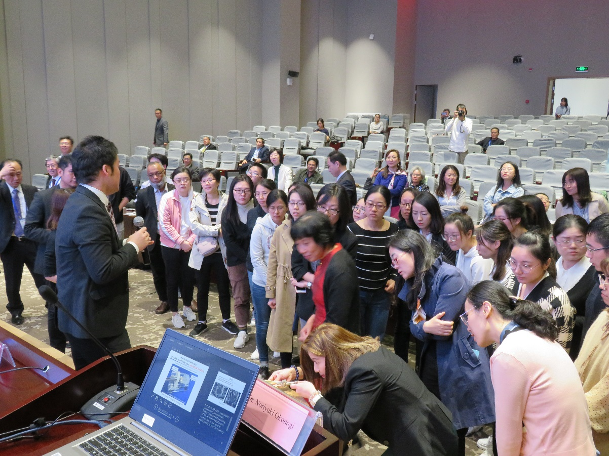
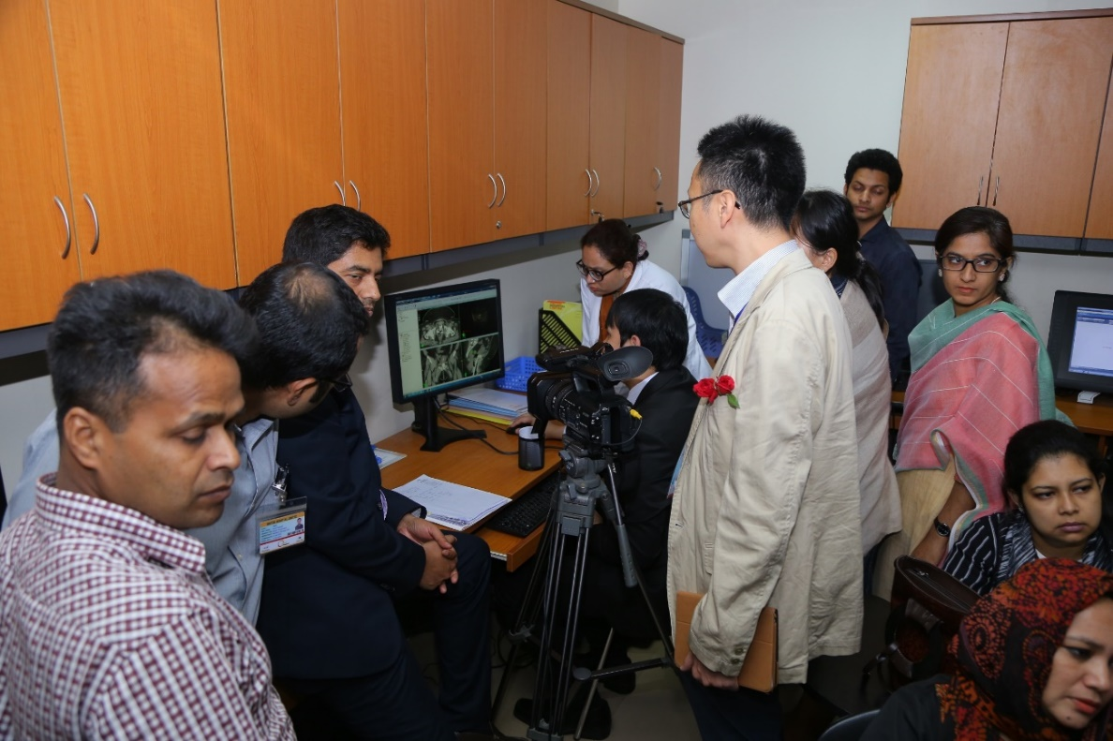
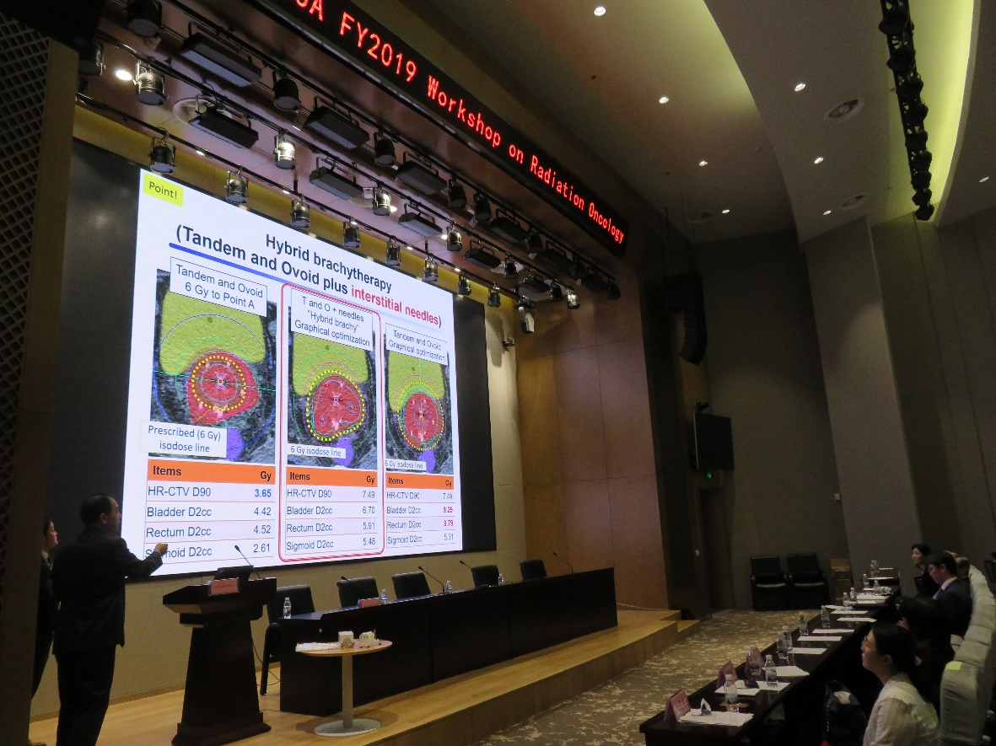
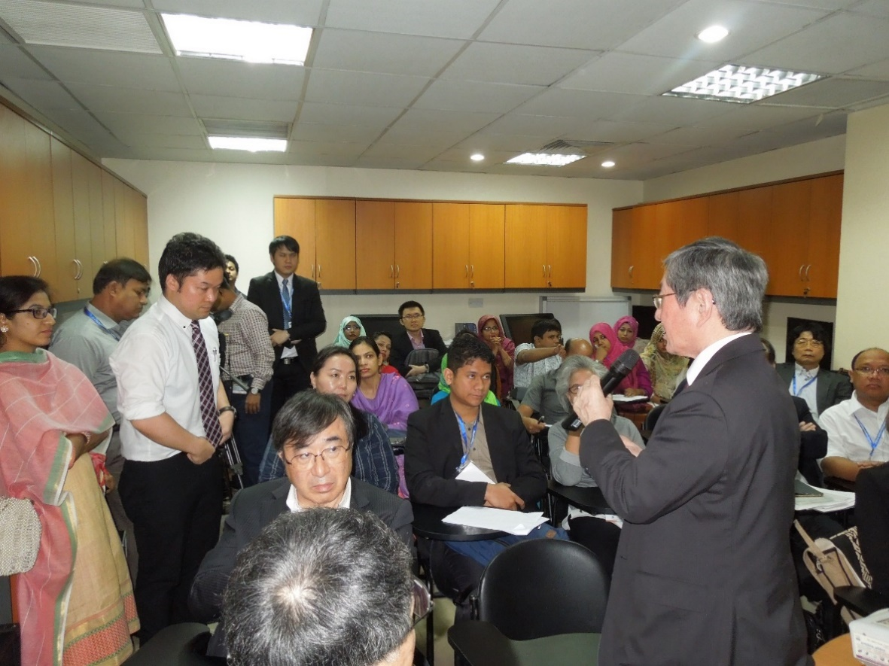
Hands-on training on 3D-IGBT at FNCA WS
in Dhaka (2018) and Suzhou (2019)
Notes:
3D-IGBT is a high-tech radiotherapy, and training of medical personnel is very important to implement this treatment.
Hands-on trainings were held in Dhaka Bangladesh and in Suzhou China. FNCA experts demonstrated insertion of applicators and 3D-IGBT planning. Many local doctors and medical physicists participated in the trainings.

Slide 26
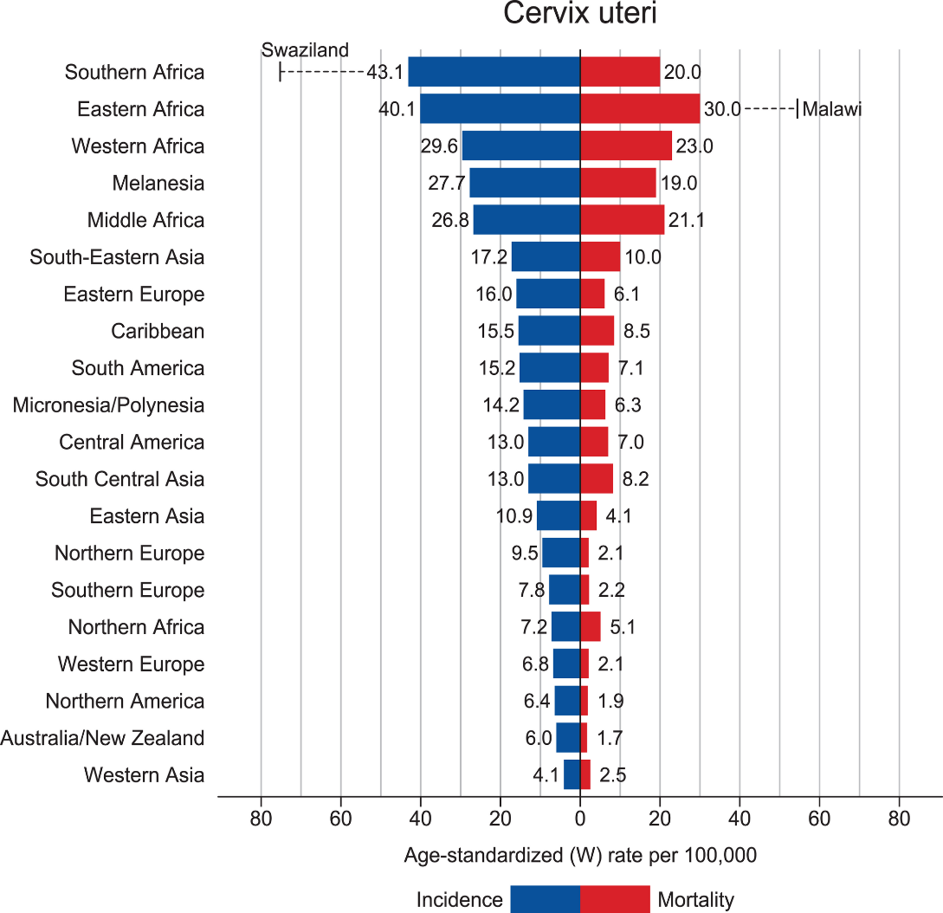
Global impact of CCRT + 3D-IGBT for cervical cancer
428,000 newly diagnosed patients (282,000; advanced stage)/year in Asia, Africa, central/south America, and Melanesia.
CCRT (+ 3D-IGBT) may improve survival of advanced cancer from 40% to 70%, which indicates possible increase of 85,000 cancer survivors/year in the world.
Notes:
This is the last slide.
There are approximately 428,000 newly diagnosed cervical cancer patients a year in the world, and approximately 282,000 patients have advanced stage of the disease.
The modern treatment, including CCRT and 3D-IGBT, may improve the survival rate of advanced cervical cancer from 40% to 70%. It indicates the possible increase of 85,000 cancer survivors a year in the world, when using the modern skills and technology of radiotherapy.
Off course, this is a rough estimate. But I hope the FNCA activities will increase trained medical personnel and contribute to the improvement of RT in Asia, Africa, and Latin America.
Thank you very much for your attention.

